Slide 1




Servant Leadership
Case Study 3 Starbucks
Presented by: P. Sree Likithaa, Praveen

Slide 2

DEFINITION
What is Servant Leadership?
Serving Others First
Aleadershipphilosophythat prioritizes the needs of employees and teams
above the leader's own interests.
Growth & Empowerment
Focusedonnurturingthepersonal and professional growth, well-being, and
empowerment of people.
Coined by Robert K. Greenleaf
TheconceptwasintroducedbyRobertK. Greenleaf in his landmark 1970
essay "The Servant as Leader."

Slide 3
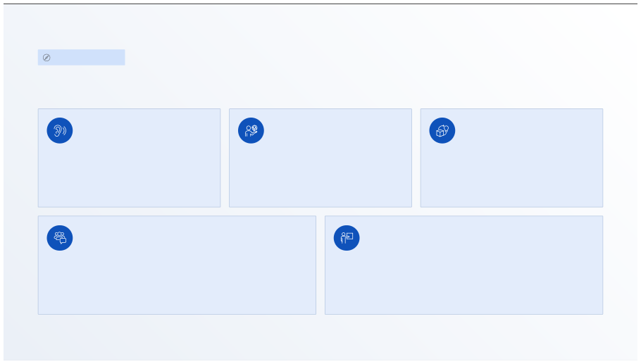
CORE FRAMEWORK
Key Principles of Servant Leadership
Listening & Empathy
Stewardship
Commitment to Growth
Genuinelyhearingand understanding the perspectives and needs of others.
Takingresponsibility for the well-being of the team and the organization.
Investinginthelong-termdevelopment
of every individual in the organization.
Building Community
Leading by Example
Creatingastrongsenseofbelonging, trust, and shared purpose within teams.
Demonstratingthevaluesand behaviors expected of every team member.

Slide 4

CHARACTERISTICS
The Servant Leader
Humble
Supportive
Placesteamsuccess above personal recognition.
Providesresources, encouragement, and backing.
Ethical
People-First
Leadswith honesty, transparency, and integrity.
Alwaysputsthehuman element at the center.

Slide 5
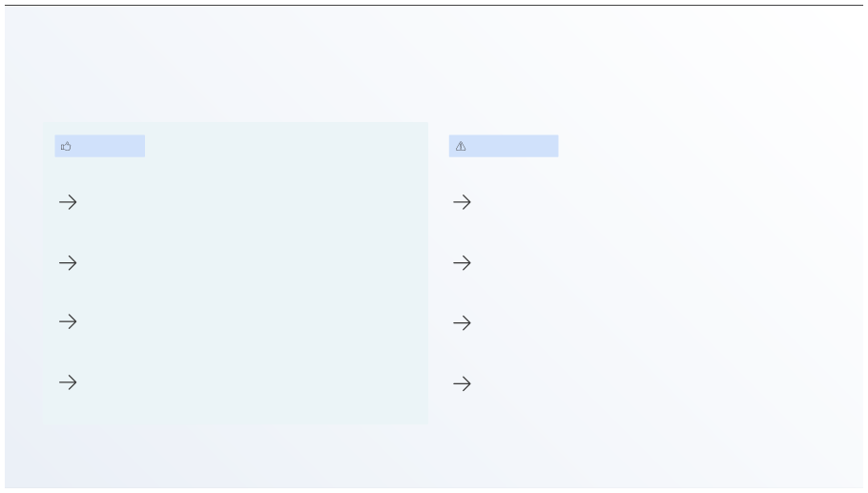
Pros & Cons of Servant Leadership
ADVANTAGES
CONSIDERATIONS
Pros
Cons
High Employee Satisfaction Teams feel valued and motivated to perform
Slower Decision Making Emphasis on consensus can delay time-sensitive actions
Better Teamwork Collaborative culture with strong cohesion
High Emotional Toll Deep empathy can lead to burnout for
leaders
Increased Productivity Empowered employees go above and beyond
Hard to Measure Long-term benefits are sometimes difficult
to quantify
Builds Trust Long-term loyalty within teams and
stakeholders
Cultural Resistance May face pushback in traditional top-
down organizations

Slide 6
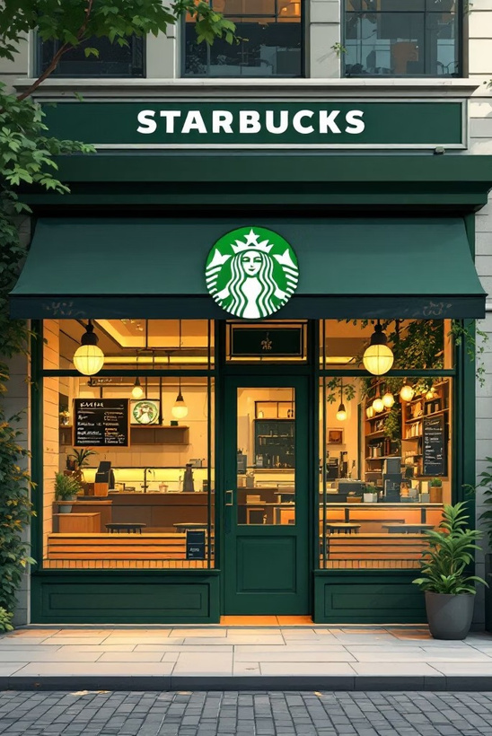
CASE STUDY
About Starbucks
1971
35K+
400K+
Seattle, Washington, USA
Storesin80+countries worldwide
Employeesreferredtoas
"partners"
Starbucks is one of the world's most recognized coffee brands 4 built on a
culture of people-first leadership and exceptional customer experience.

Slide 7

SERVANT LEADERSHIP IN ACTION
Why & How Starbucks Practices Servant Leadership
Why Starbucks Embraces It
How They Practice It
01
Comprehensive Benefits
"Partners," Not Employees
Respect & Inclusion
Everyteam member iscalleda partner 4 reflecting mutual respect and shared ownership.
Aculture ofdignityandbelonging is
Healthcoverage,stockoptions,and tuition support 4 even for part-time partners.
central to Starbucks' identity.
02
Happy Employees = Happy Customers
Training & Development
Ongoinglearningprogramstogrow skills and advance careers within the company.
Corebelief:investinginpeopledirectlydrivesexceptional customer experience.
03
Open Communication
Leaderslistenactivelyandcreate safe spaces for feedback at every level.
04
Supportive Leadership
Managersaretrainedtocoach,support, and remove obstacles for their teams.

Slide 8

OUTCOMES
Benefits Starbucks Achieved
High Employee Loyalty
Strong Brand Reputation
Lowerturnoverratesthanindustry average, driven by genuine care for partner well-being.
Recognizedgloballyasoneoftheworld's most admired and ethical companies.
Excellent Customer Service
Global Expansion
Engagedemployeesconsistentlydeliver warm, personalized customer experiences.
Scaledsuccessfullyto80+ countries, sustained by a replicable people-
first culture.

Slide 9






KEY INSIGHT
Case Study Insight
People-First Leadership Leads to Success
Culture Drives Performance
Ideal for Service Industries
A strong,inclusiveculturebuiltontrust is a powerful and sustainable competitive advantage.
Servant leadershipis especially
Whenleaders investintheirpeople, performance and profits naturally follow.
effective in customer-facing environments where frontline engagement matters most.

Slide 10

CONCLUSION
Key Takeaways
Serve First
1
Servant leadership centers on serving others 4 putting people before process and profit.
Build Trust
2
Itcreateslasting loyalty, strong culture, and long-term organizational
success.
Starbucks Proves It Works
3
Aglobalbrandbuiltonempoweringits partners 4 a benchmark for
sustainable leadership.
Recommendation: Servant leadership is highly recommended for
organizations in service industries seeking sustainable growth, strong culture, and long-term employee retention.

